Slide 1
IMPACT OF PANDEMIC ON STARTUPS IN INDIA
Submitted By - Gauri Girdhar
Symbiosis Law School, Pune

Slide 2
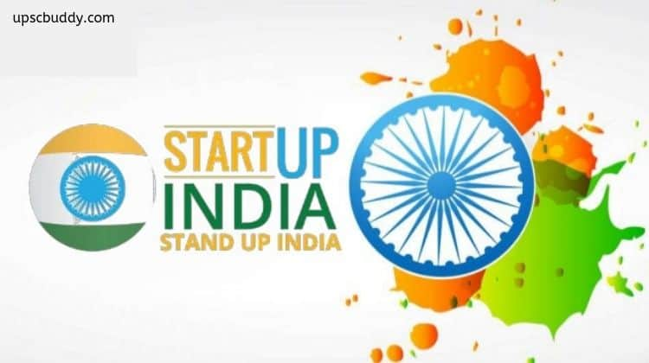
What is a Startup?
According to Startup India Scheme, 2016, it is an initiative with the existence of 10 or fewer years, incorporated as a Private Limited Company, a Registered Partnership Firm or a Limited Liability Partnership, having less than 100 million annual turnover per annum and headquartered in India.
They are Young Ventures with a Unique Business Model and a Unique Idea, just beginning to develop.

Slide 3
Characteristics of a Startup
Unique business idea.
Identifies and addresses a significant societal issue.
Work on a product, method, or service's production
or improvement.
Have a business model that is scalable.
Strong potential for wealth and job growth.

Slide 4
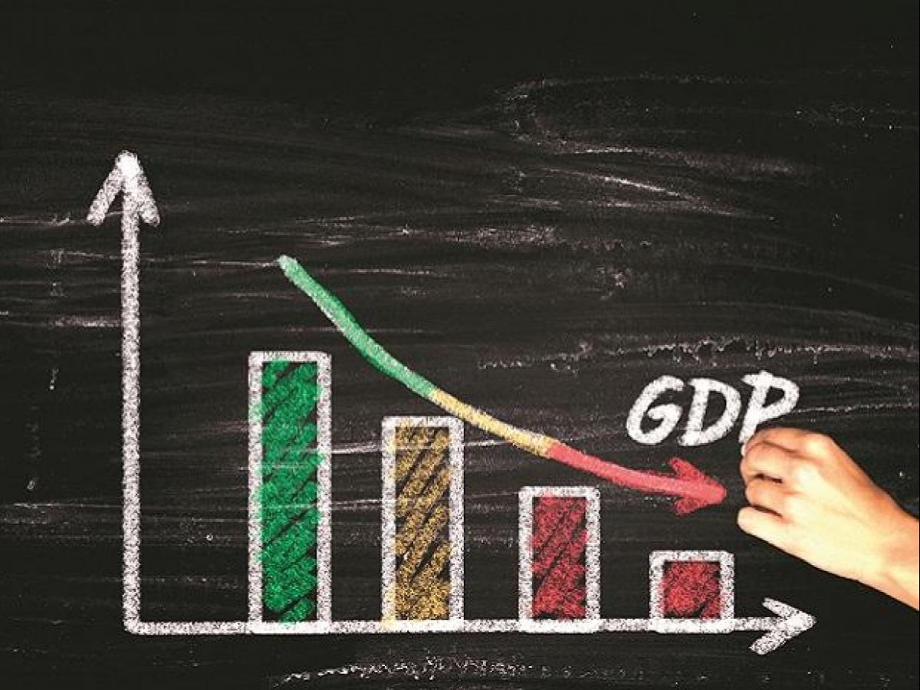
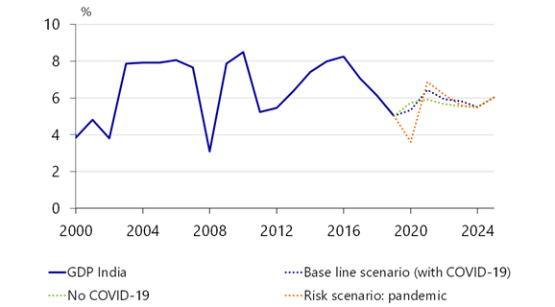
Impact of COVID-19 on Indian Economy
The pandemic has had a major effect on India's economic activity as well as the loss of human lives with more than 130 million cases and 2.84 million deaths.
Up to 53% of companies in the country were expected to be impacted significantly.
According to the Ministry of Statistics, India's growth slowed to 3.1% in the fourth quarter of fiscal year 2020.
Projection estimates that around 14 crore people lost employment while salaries were cut for many others and all this amount to a loss over Rs 32,000 Cr every day during the first 21 days of complete lockdown.

Slide 5
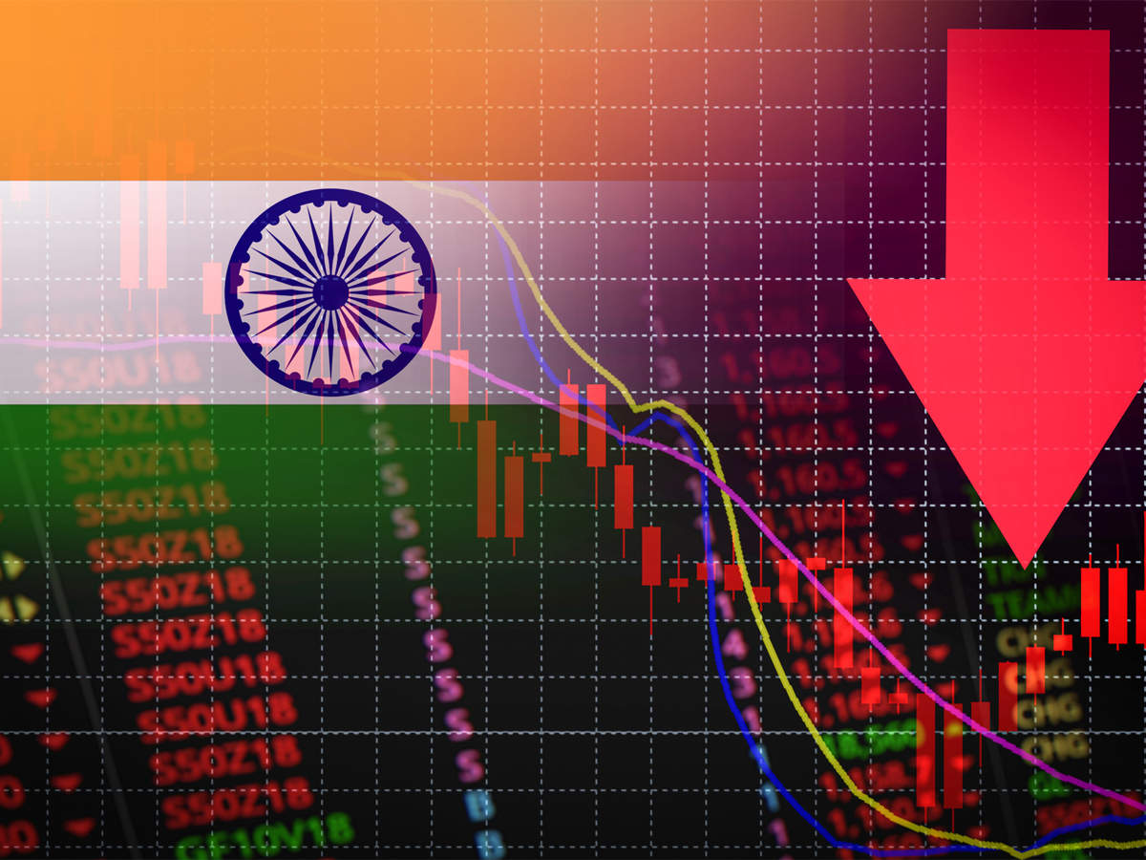
Impact of COVID-19 on Indian Economy
Young startups have been impacted as funding has fallen.
Big corporate houses & PSUs had to suspend services or significantly reduced operations. Among the most hit sector is Tourism & hospitality which contributes to 10% of Indian economy and worst part is that it will long time to recover too.
Stock markets in India posted their worst loses in history on 23 March 2020 and till date it has not recovered the pre covid level in spite of various sincere efforts by government.
Fast-moving consumer goods companies in the country have significantly reduced operations and are focusing on essentials.

Slide 6
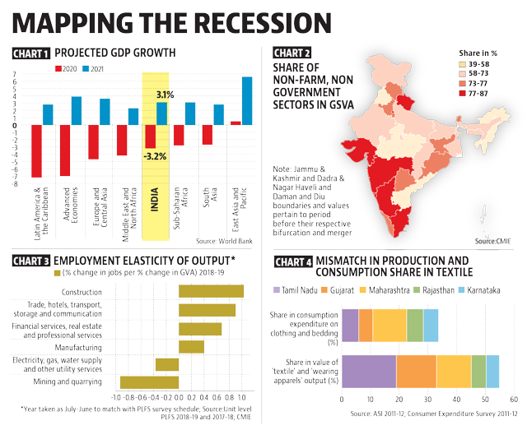

Slide 7
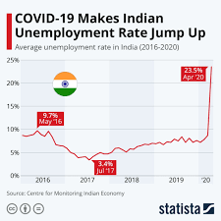

Slide 8
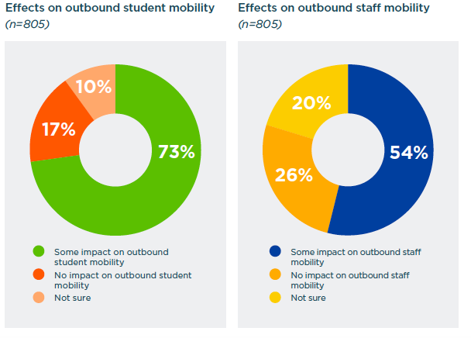

Slide 9
Why is Startup sector most vulnerable?
People entering startup industry are mostly small entrepreneurs or owners with a unique idea.
Most of the time they gather their own funds to invest in a startup.
Not many resources are available to them.
The use of manpower is more and the techniques used are more labor intensive than capital intensive at the initial level.
COVID-19 has created a problem for allocation of resources as well as increased the level of risk in investments.

Slide 10
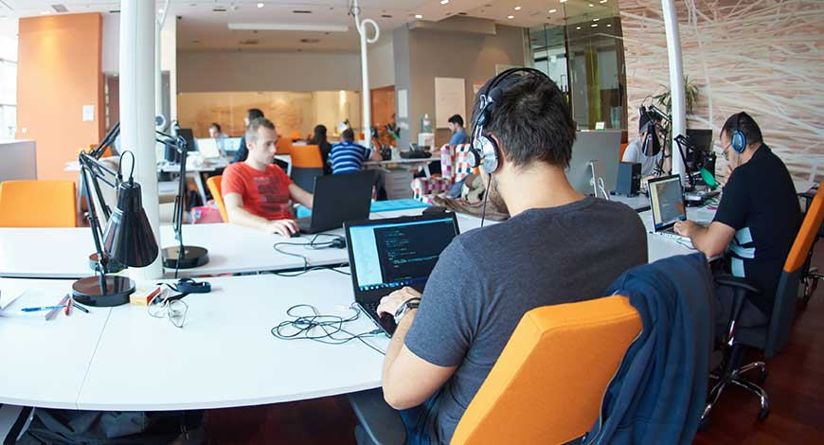
Indian Economy & the Startup Industry
India is now the world's third-largest startup hub, with a huge commercial opportunity for entrepreneurs.
Bangalore is the startup capital of India.
The startup sector has seen a dramatic increase in funding, from $550 million in 2010 to $14.5 billion in 2019.
In 2020, India has 38,756 officially recognized startups and 27 unicorns.
In 2016, Prime Minister Narendra Modi unveiled the Startup India Scheme to bolster the startup industry.

Slide 11
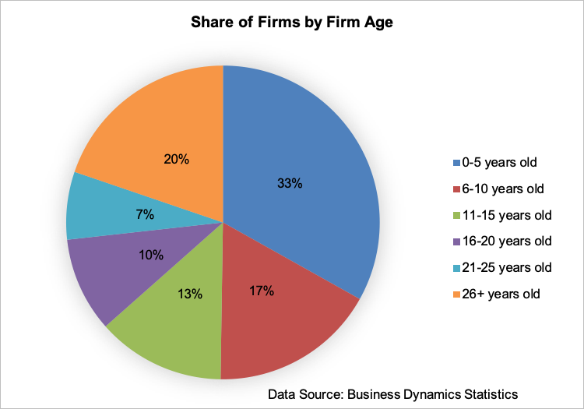

Slide 12
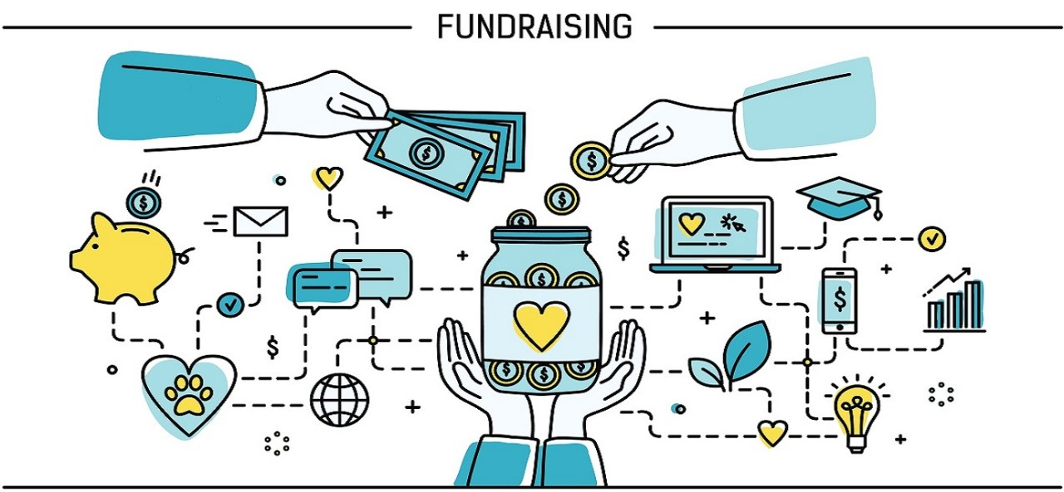
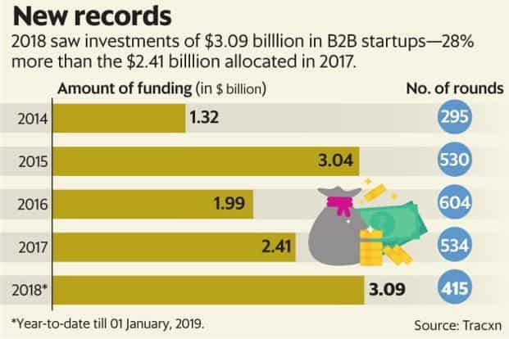
Impact of Pandemic on Startup Industry
Sourcing of Funds/Investments
Funding is the most important and critical component of any startup, particularly in its early stages.
According to the survey titled "Impact of COVID-19 on Indian Startups," investors have placed their decisions on hold for 33% of startups, while 32% have received no answer.
The remaining 17% have yet to receive funds, and 10% have had their contracts cancelled.
Startup investments will continue to be affected in the coming months, according to investors polled by Indian Angle Network and FICCI.

Slide 13
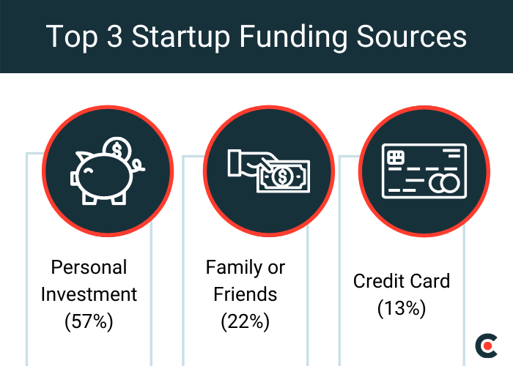

Slide 14
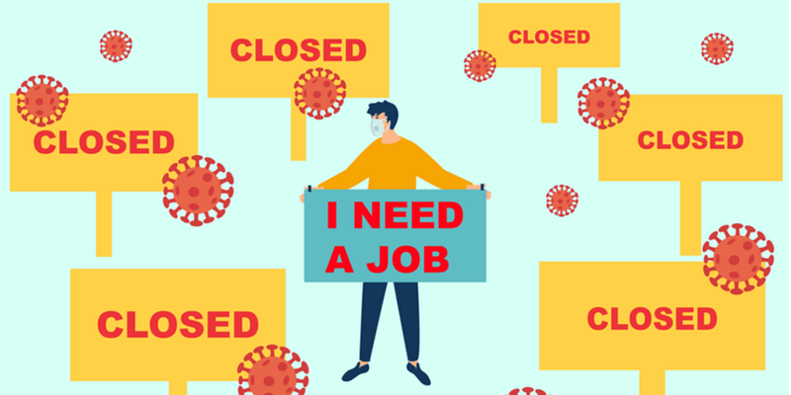
Impact of Pandemic on Startup Industry
Hiring
According to the Centre for Monitoring Indian Economy (CMIE), a private-sector think tank, the lockdown cost 122 million jobs in the first month.
In April, 17.7 million salaried workers were lost.
In May, the loss was reduced to 100.3 million, and then to a much smaller 29.9 million in June.
The number of people who have lost their jobs has decreased to 11 million in July.

Slide 15
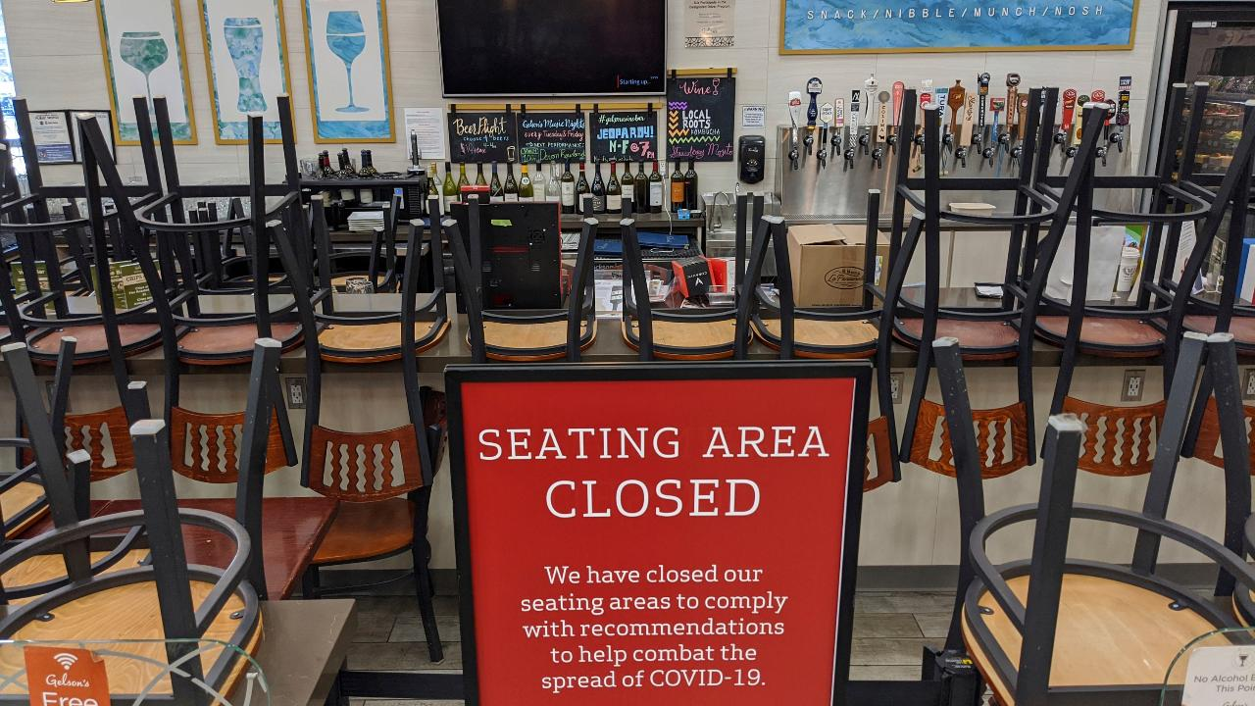
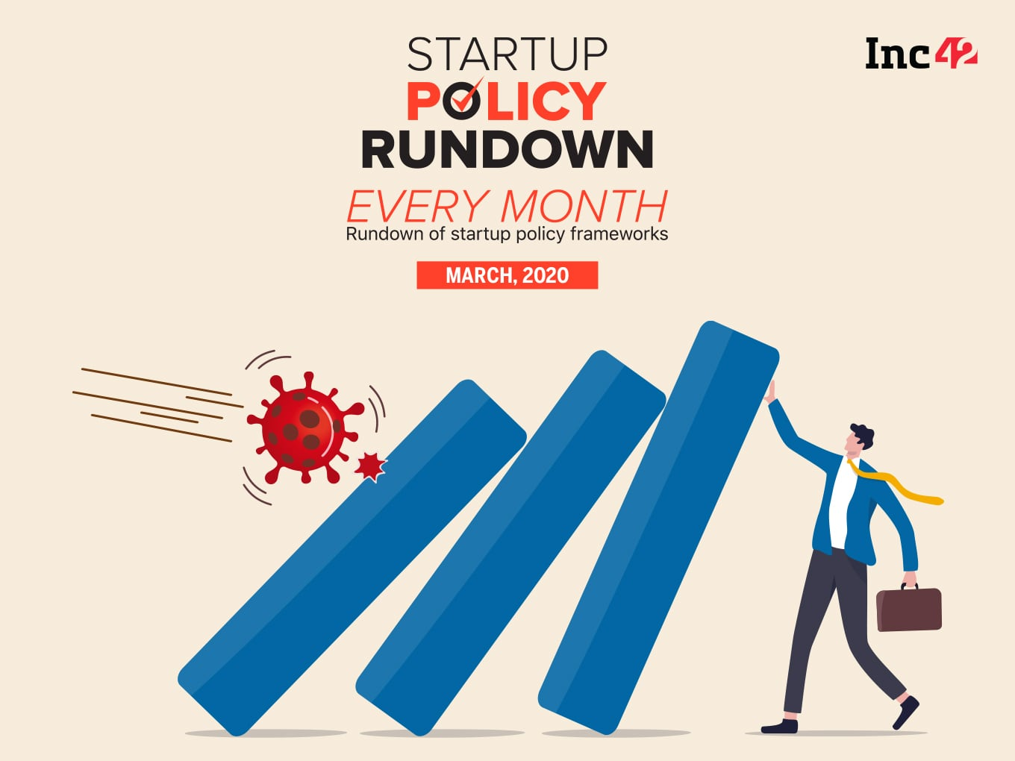
Impact of Pandemic on Startup Industry
Economic Slowdown
The Startup industry contributes $14.5 billion to the Indian economy, according to the "India Tech Annual Factsheet-2019.
In the one hand, the pandemic hampered cashflows and savings, while on the other hand, many people lost their jobs.
As a result, GDP decreased to some extent, resulting in an economic downturn.

Slide 16
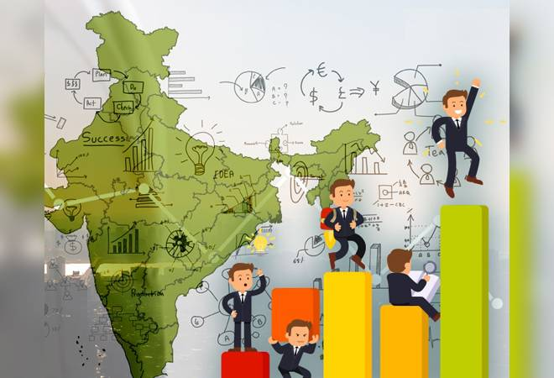
Impact of Pandemic on Startup Industry
A decline in the Startup Ecosystem
According to NASSCOM's Start-up Pulse Survey-Q1 2020 report, Reviving the Indian Start-Up Engine During Covid19: Imperatives and Recommendations (released in May), 90% of Indian startups are experiencing revenue declines, 70% have a runway of less than three months, and 30-40% are in the process of temporarily or permanently shutting down.

Slide 17
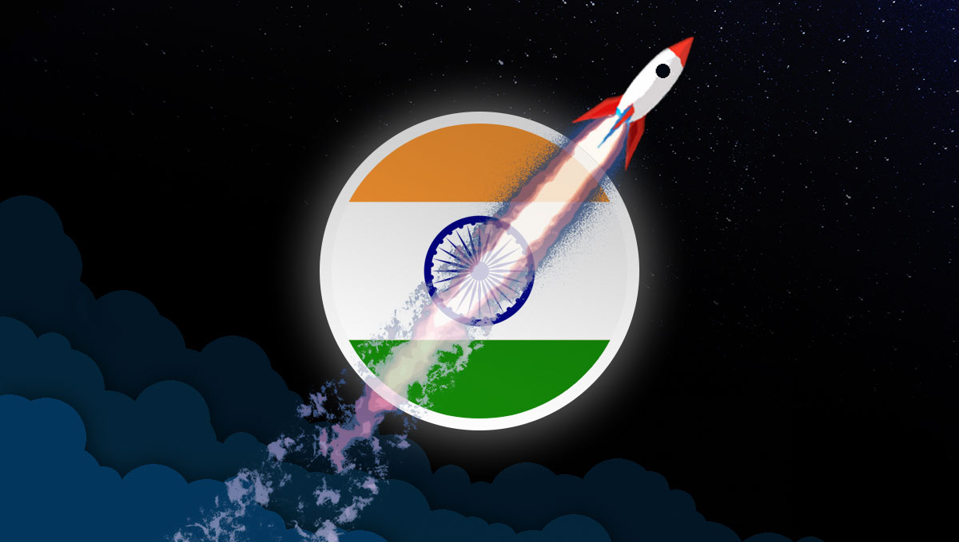
Impact of Pandemic on Startup Industry
Growth of new Startups
New entrants are declining in a variety of sectors, including fintech, banking, and business applications.
The total number of tech start-ups in India fell by 44.4% i.e., 5,509 to 3061.

Slide 18
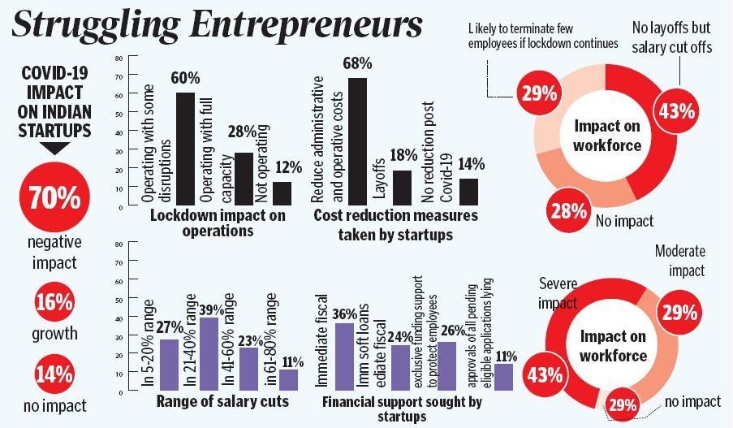

Slide 19
Role of technology in functioning of startups during the Pandemic
The technology has played a major role in functioning the startups online.
Admits pandemic, the need of the hour was work from homes.
Startups based on technology saw a drastic surge.
From mid-October to November, online sales hit $8.3 billion in gross merchandise value (GMV), up from $5 billion the previous year, according to management consulting firm Redseer.
In 2020, the biggest change will be on the consumer side, as technology will have spread to smaller cities.

Slide 20
Conclusion
Startups in India are most vulnerable entities and are currently undergoing a golden age.
The lockdown has affected not only everyday business activities but has also forced many start-ups to prepare contingency plans to reduce workforce and employee wages.
The pandemic has brought years of changes in the way these companies deal and work.

Slide 21
References
Impact of Pandemic on Startups in India, http://legalstartups.info/blog-detail.php?id=57, (Last Accessed on April 21, 2021)
Startups in India, https://www.drishtiias.com/daily-updates/daily-news-editorials/startups-in-india-1, (Last accessed on April 05, 2021)
Lucy Rana & Vibhuti Vasisth, Impact of Covid-19 on Start-Ups, https://www.mondaq.com/india/operational-impacts-and-strategy/949762/impact-of-covid-19-on-start-ups, (Last accessed on April 04, 2021)
Sandeep Soni, Covid-spooked startup funding may not fully recover this year; majority investors not looking for deals, https://www.financialexpress.com/industry/sme/covid-spooked-startup-funding-may-not-fully-recover-this-year-majority-investors-not-looking-for-deals/2013967/, (Last accessed on April 05, 2021)
Tarush Bhalla, Startups think out of the box to beat covid-induced disruptions, https://www.livemint.com/companies/start-ups/startups-think-out-of-the-box-to-beat-covid-induced-disruptions-11609257920165.html, (Last accessed on April 06, 2021)

Slide 22
THANKS!
I would be happy to answer
the questions, if any?

